Slide 1

Unleashing the Potential:
Large Language Models in SOC2 Governance
True Security | Fanatic Support | Business Value
03

Slide 2
Table of Contents
Introduction
Problem Statement
Solution
Future Scope

Slide 3
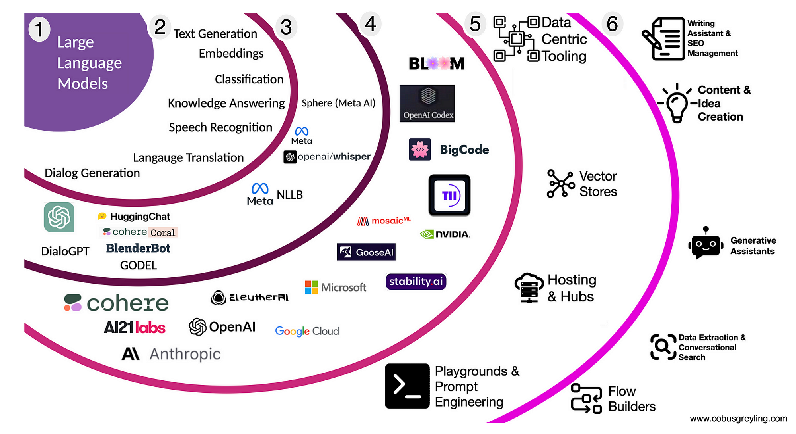
Introduction
What is LLM?
A Large Language Model (LLM) refers to a type of artificial intelligence (AI) model that is designed to understand and generate human-like language.
These models are typically trained on massive datasets containing diverse examples of human language, such as books, articles, and websites.
During the training process, the model learns the patterns, structures, and relationships inherent in language, allowing it to perform a wide range of natural language processing (NLP) tasks

Slide 4
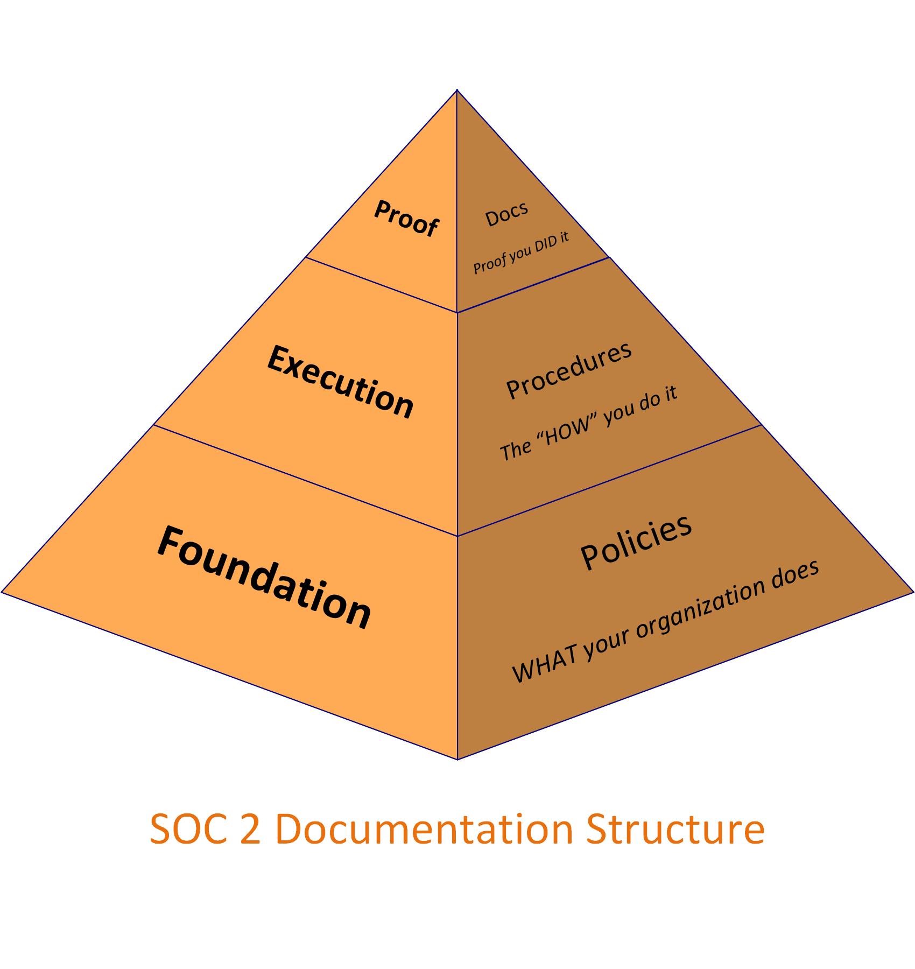
Problem Statement
SOC2 Governance
SOC 2, which stands for Service Organization Control 2, is a framework for managing and securing sensitive information in the cloud.
Governance is a crucial component of SOC 2, and it encompasses the policies, procedures, and overall management of an organization's information security program.
Now Take a case where there is a huge team, and someone wants to know about a specific team of how they are working, their process and activities, so they need to go through a lot of documents.

Slide 5
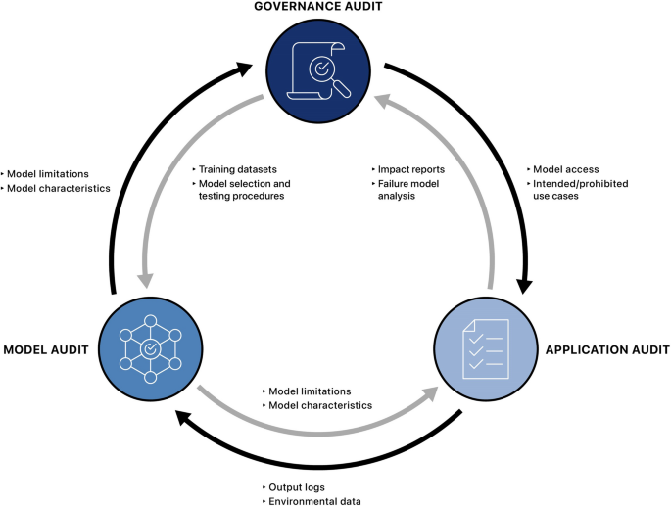
Solution
How LLM is coming in picture?
LLM or Large Language Models, will be responsible for going through all the different documents and the result would be a simple UI like Chat GPT
Now you can be able to ask specific questions you want to get more insights on. The information which would be provided would be tailored according to your needs
https://link.springer.com/article/10.1007/s43681-023-00289-2/figures/2

Slide 6
DEMO

Slide 7
Future Scope
Finetuning the model to give more accurate results
Future team documentation systems could offer more customization based on user roles and needs. A Team Member might have tailored views, ensuring they see only the information relevant to their responsibilities.

Slide 8







Thank You!
www.sisainfosec.com
Thank You!
Follow Us:

